Slide 1
An overview of the SAT and ACT (2017 – 2018)

Slide 2
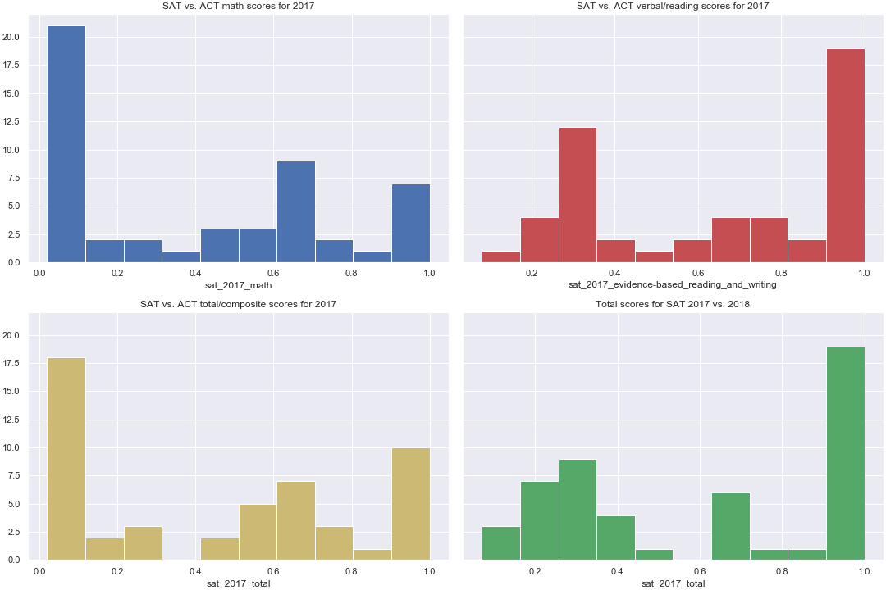
Comparing SAT 2017 scores to participation rate
Scores seem to be skewed to the left and right of the graph respectively.

Slide 3
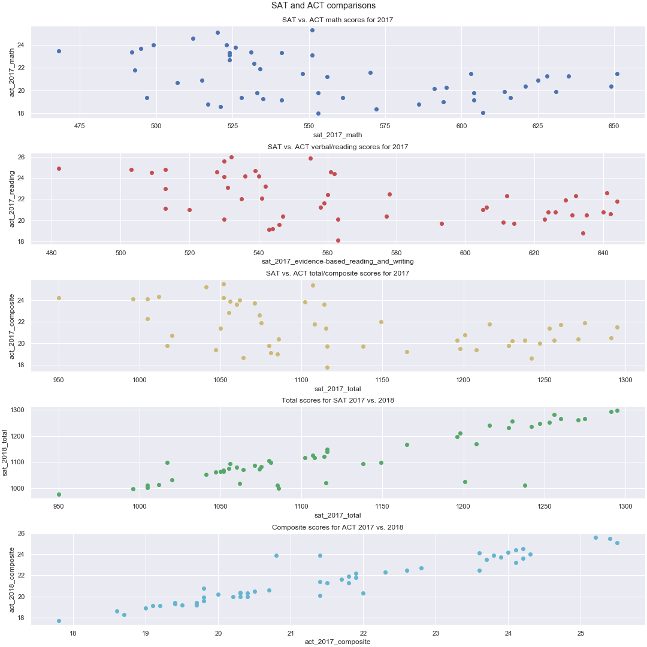
Comparing SAT scores to ACT scores
Clear correlation between SAT 2017 and SAT 2018 total score.
This is also seen in the ACT 2017 and ACT 2018 total score
A somewhat negative correlation can be seen between ACT and SAT test scores

Slide 4
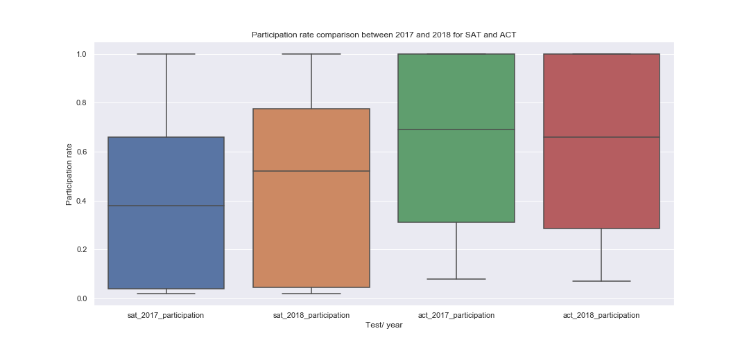
Comparing SAT and ACT participation rate
SAT 2018 interquartile range has increased from SAT 2017

Slide 5
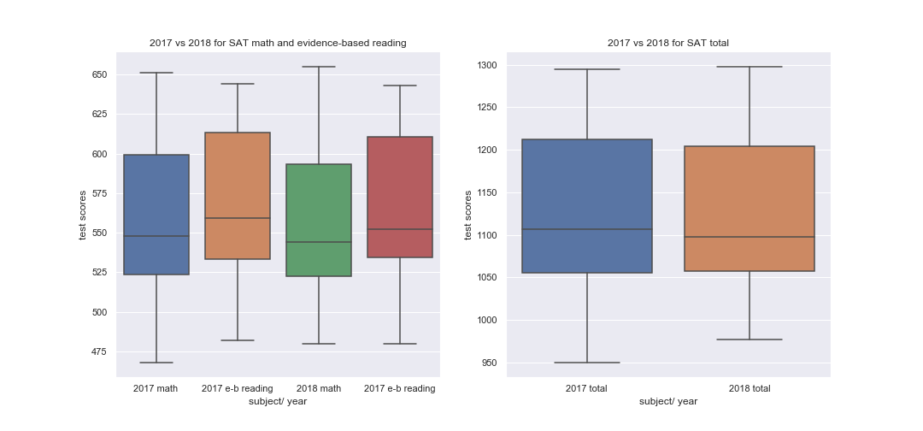
Comparing 2017 SAT to 2018 SAT scores

Slide 6
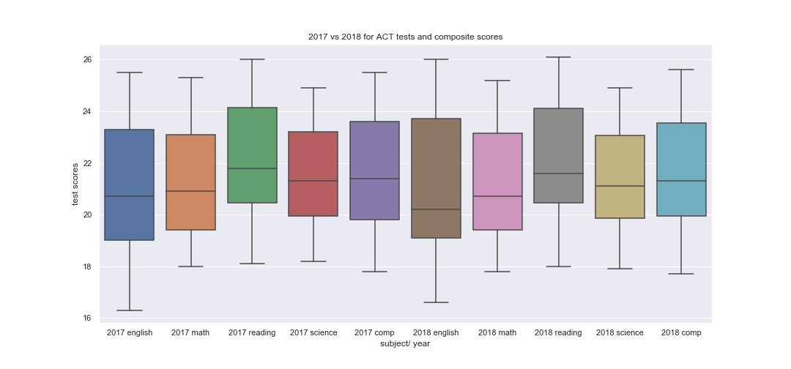
Comparing ACT 2017 to ACT 2018 scores
ACT scores for reading seem to be consistently better than the rest

Slide 7
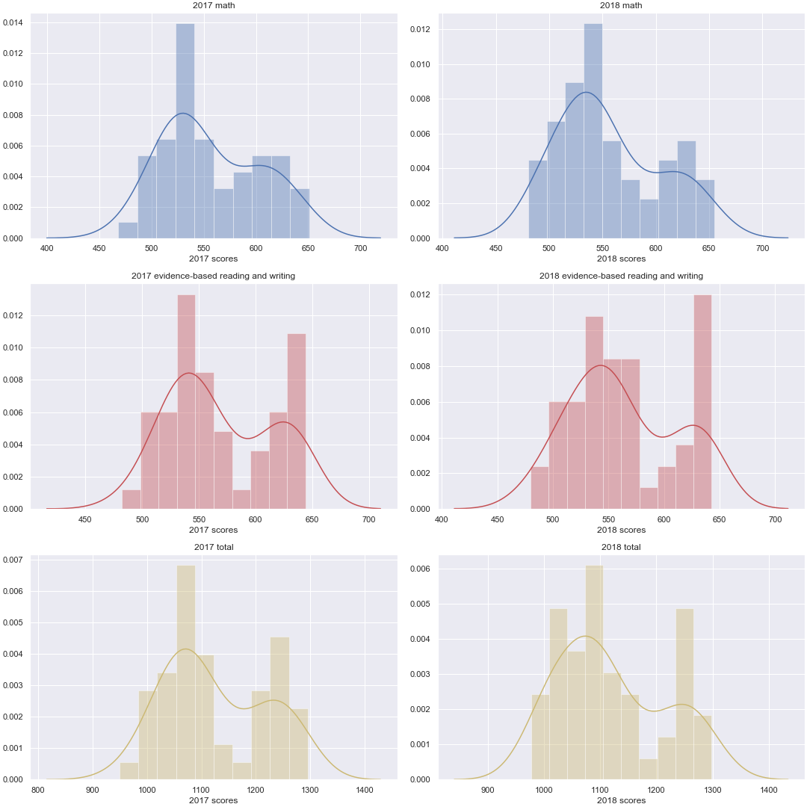
SAT score distribution
A somewhat normal distribution can be observed for SAT test scores

Slide 8
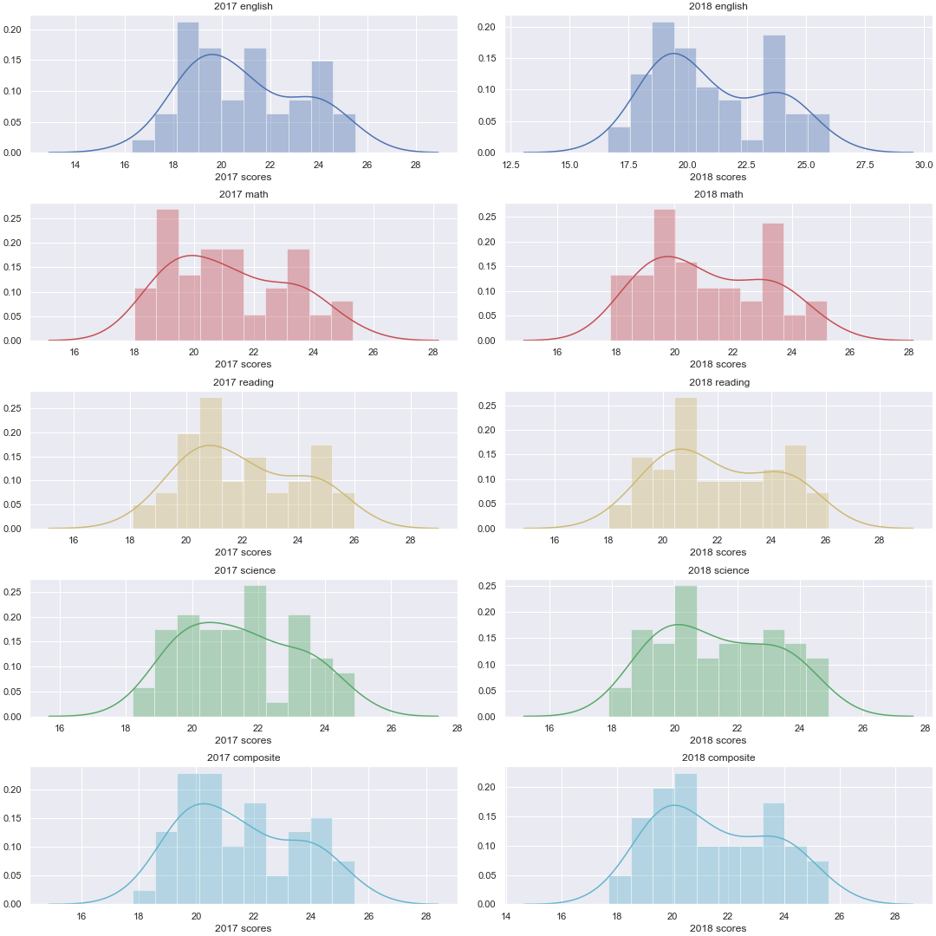
ACT score distribution
A somewhat normal distribution can be observed for ACT test scores

Slide 9
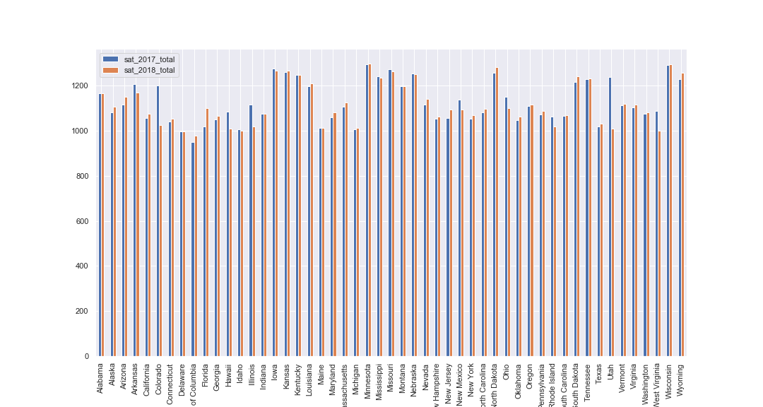
Comparing total SAT scores for each state for 2017 and 2018

Slide 10
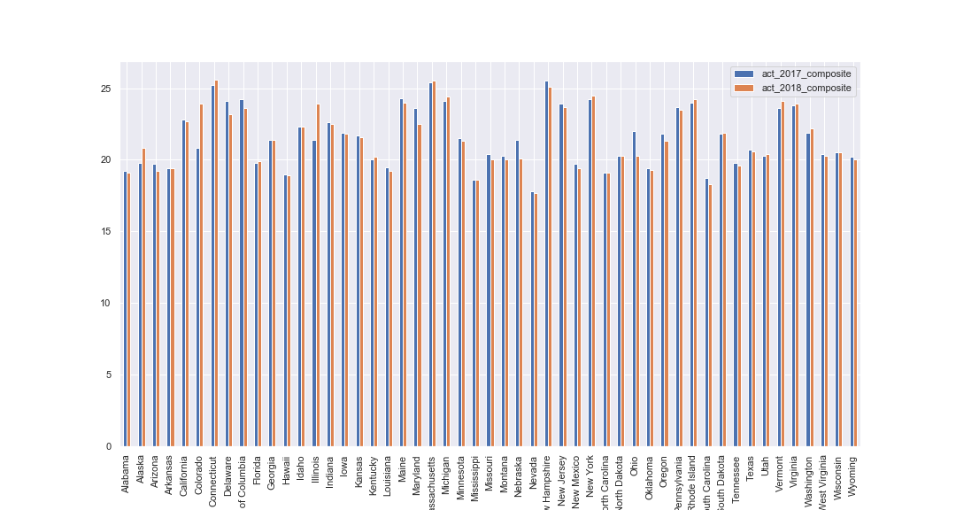
Comparing ACT scores for each state for 2017 and 2018

Slide 11
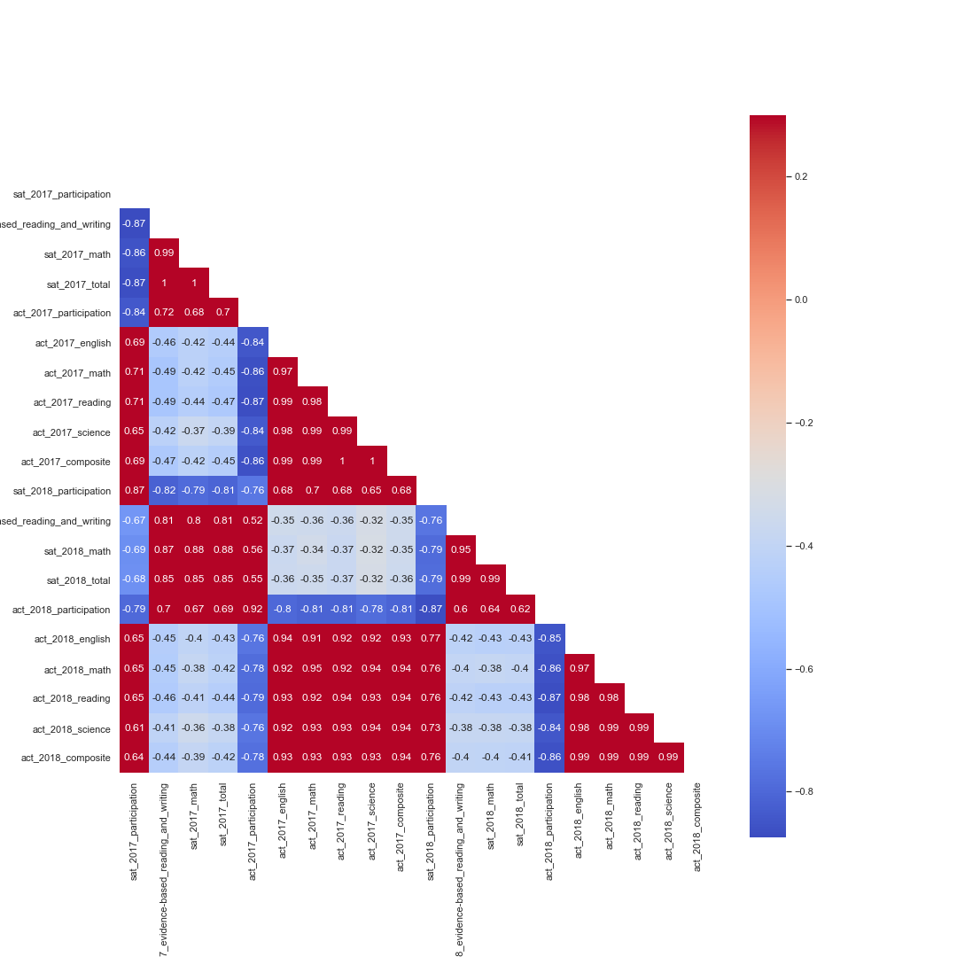
Observing patterns between the data
Noticeable pattern of correlation

Slide 12
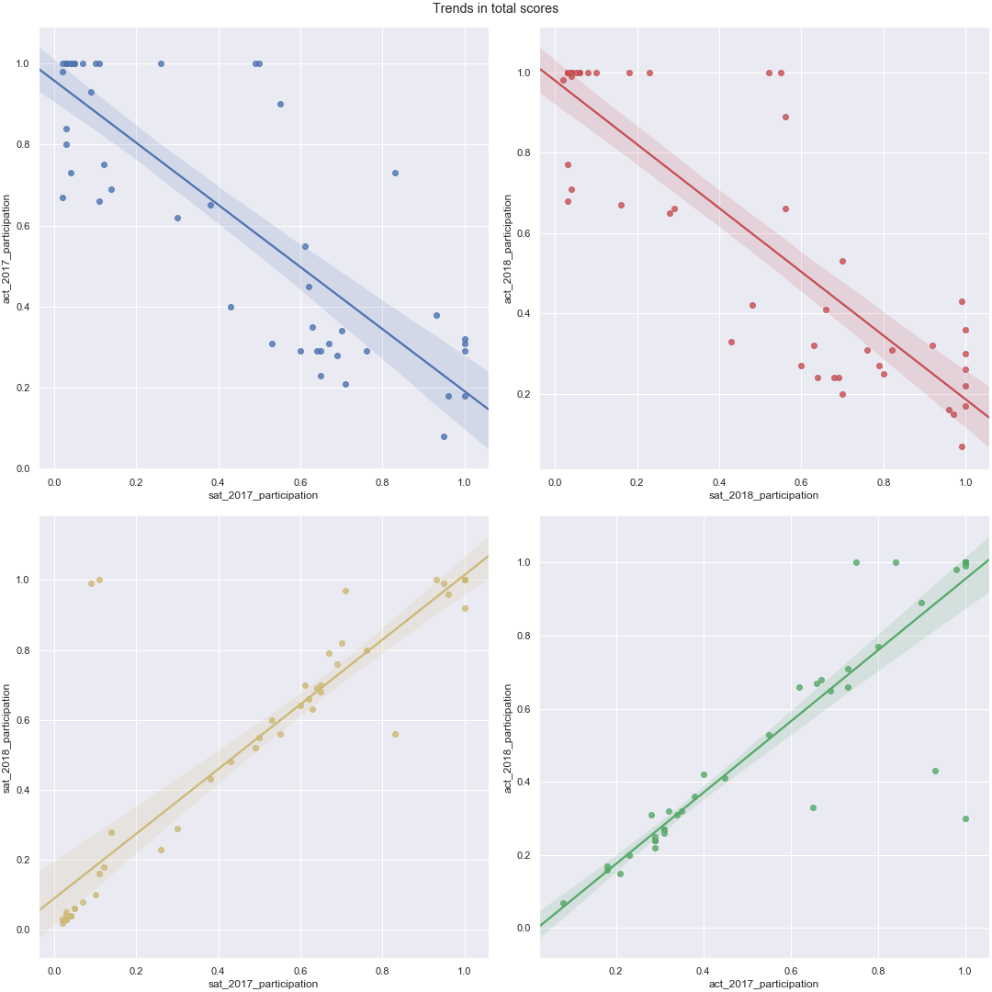
Noticeable trends
Trend observed between act and sat participation

Slide 13
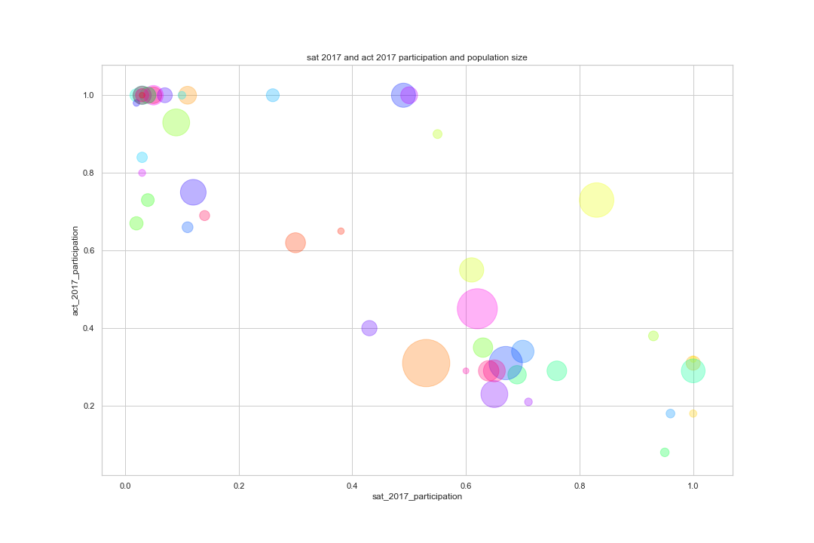
SAT and ACT participation rate (with population size)
Size of dot indicates population size

Slide 14
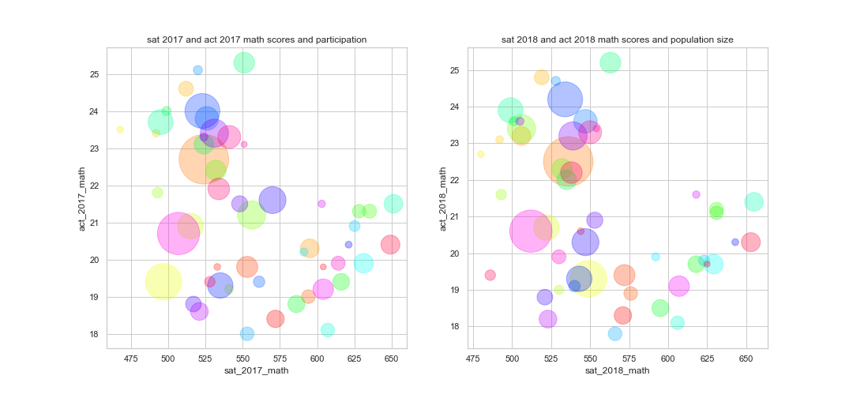
SAT and ACT test scores (with population size)

Slide 15
Hypothesis Testing
SAT math scores found to be significantly different from SAT reading scores
Same observed in ACT
Test scores between each year was not significantly different

